Slide 1


Stream processing using Kafka and Faust
Johannes Ahlmann, Sensatus.io
PyCon Limerick
2020-02-28

Slide 2

About Me
Johannes Ahlmann
Living in Cork
Developing in Python since 2002
Built large-scale Machine Learning solutions using Python, Tensorflow, Kafka, Spark
Sensatus.io
On-Prem AI Models
Gathering and Enriching Web Data
Sales & Client Intelligence
Github: @codinguncut
codinguncut/python_faust
sensatus.io

Slide 3
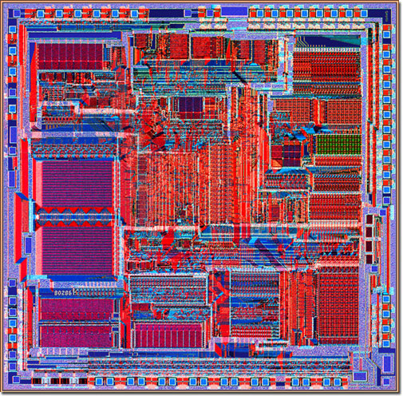

Times Have Changed
Intel 80286 1 core, 0.13M transistors
Intel i7-9900K 8 cores, 3000M transistors

Slide 4
Challenges
Many fantastic libraries written in C, Fortran, Python, Go
How can we leverage libraries together that are written in different languages, or for different (virtual) machines?
Multiprocessing and concurrency are hard in C, Python, etc.
How can we leverage compute of multiple cores per machine, let alone multiple machines
Distributed computing is hard
How can we monitor/ manage/ debug/ reason about it?

Slide 5


Computational Graph, Microservices
Internet
seen
Frontier
Fetcher
Responses
urls
html
Links
Entities
Sentiment
Metadata
urls
join
Item Store
Combined
items

Slide 6
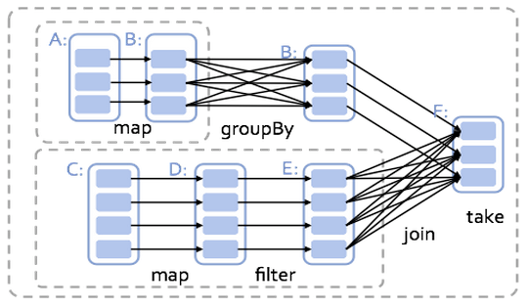
(Spark) Operator Graph

Slide 8
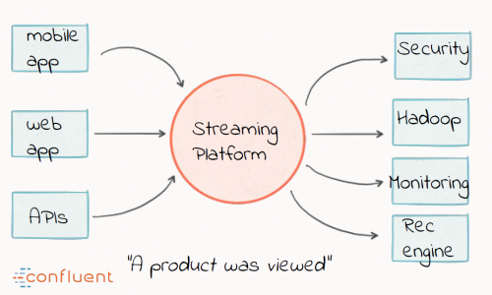
A high-throughput distributed messaging system
Decouples Data Pipelines
Scalable & Fault-Tolerant
Kafka Functionalities
Messaging
Processing
Storing
Performance (>100k/s)
Batching
Zero Copy I/O
Leverages OS Cache
Durability
Image Credit: Confluent

Slide 9
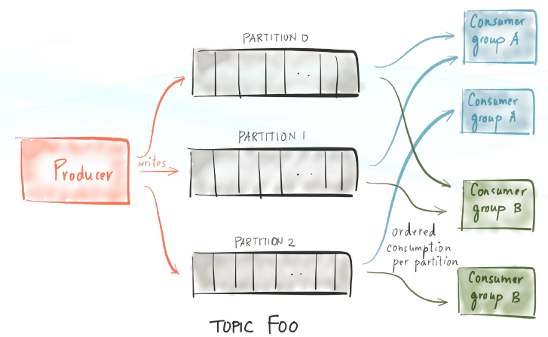
Core Concepts
Producers
Consumers
Brokers
Topics
Zookeeper
Offsets
Broker Addresses
Image Credit: Confluent

Slide 10
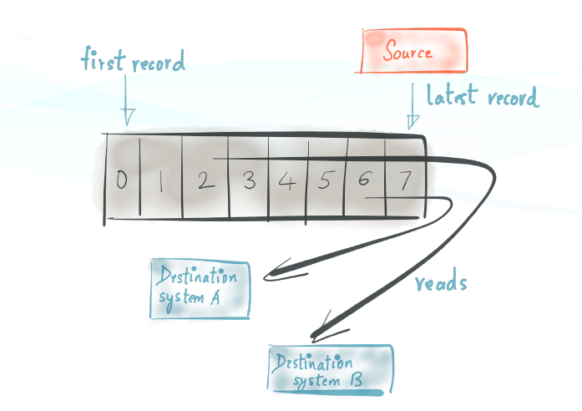
Logs & PubSub
Consumers can be transient
Consumer Groups
Delivery Semantics
at least once (default)
at most once
exactly once
Retention Policy
Reprocessing
Image Credit: Confluent

Slide 11
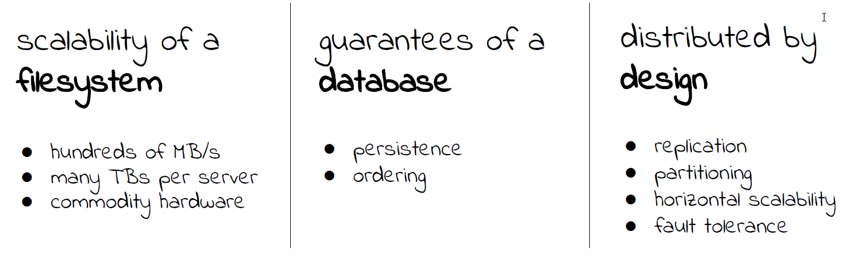
Summary
Image Credit: Confluent

Slide 12


Slide 13
Faust
Low overhead, start simple, scale out
Use Kafka as a persistent transport mechanism, even between languages
Replay, reprocess
High Availability, Checkpointing, Error Recovery
Per-agent scaling
Regression testing
Python kafka wasn't fun

Slide 14
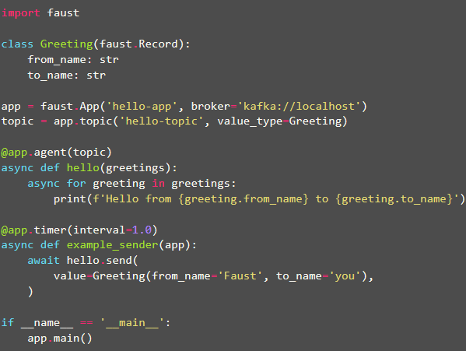

Slide 15
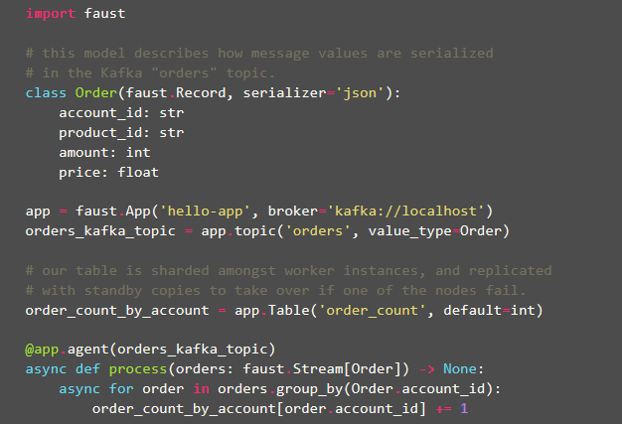
Tables

Slide 16
Demo Time

Slide 17
Alternatives
Faust | A stream processing library, porting the ideas from Kafka Streams to Python. It provides both stream processing and event processing, sharing similarity with tools such as Kafka Streams, Apache Spark/Storm/Samza/Flink,
Ray | A fast and simple framework for building and running distributed applications.
Dask | Provides advanced parallelism for analytics, enabling performance at scale for the tools you love
Spark | A unified analytics engine for large-scale data processing.
Celery | Celery is an asynchronous task queue/job queue based on distributed message passing. It is focused on real-time operation, but supports scheduling as well

Slide 18





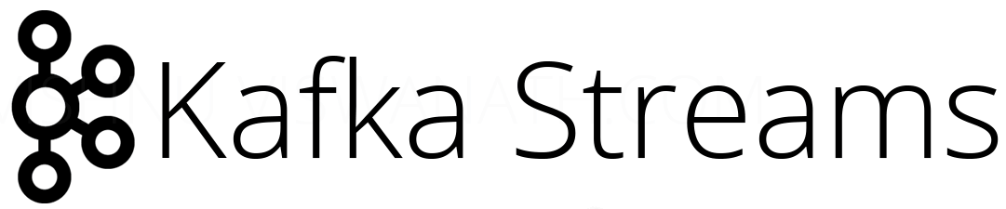
actor model
functional/ graph
stateless
stateful

Slide 19
Thank you

